Slide 1
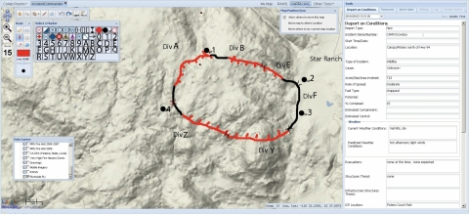
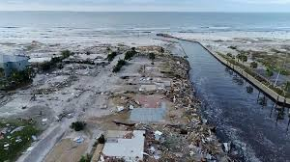
Automatic Disaster Image Annotations
Connor Grimberg & Joseph Lee
Computer Systems Laboratory
Notes:
Connor
Today, we will be specifically discussing our project: Automatic Disaster Image Annotations.

Slide 2
Overview
Background
Alarming stats.
Introducing Civil Air Patrol (CAP)
Motivation
Proposal → A.I. solution
Convolutional Neural Networks (CNN)
Web application
Retrain feature
Avenues for improvement
Notes:
Joseph:
The way I will present is by first introducing (press) the background of the problem we addressed in our research project. I will do this with (press) alarming statistics and by introducing the group we aim to help: (press) the Civil Air Patrol.
Then, I will introduce the (press) motivation for our research project.
After that, I will introduce our proposal (press), which involves artificial intelligence, and break down and explain the specific methodology we used: (press) Convolutional Neural Networks. I’ll then explain our web application (press), which is the tangible product of our research, and end off this technical part of the presentation with our (press) retrain feature.
Finally, (press) I will conclude this presentation with avenues of improvement.

Slide 3
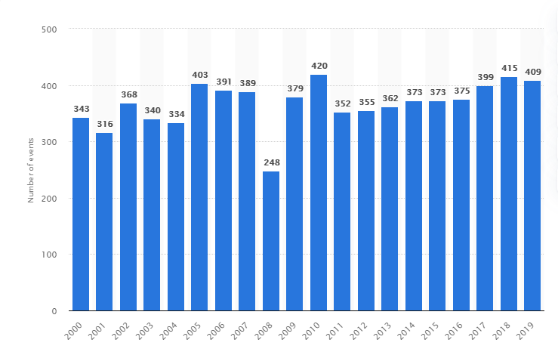
Alarming Stats for Past 20 Years
4,400,000,000 impacted
1,300,000 died
~60,000 die/year
Annual Number of Natural Disaster Events Globally from 2000 to 2019
Notes:
Connor
Over the past 20 years, 4.4 billion people were impacted by natural disasters and 1.3 million have died to them. That is about 60,000 people per year dying to natural disasters. There is usually greater than 350 disasters every year causing this.
Impacted = injured, homeless, displaced or in need of emergency assistance
https://www.unisdr.org/files/61119_credeconomiclosses.pdf
this source also applies to the "Killed 1,300,000" statistic too.
Graph source: https://www.statista.com/statistics/510959/number-of-natural-disasters-events-globally/

Slide 4
Well, what is being done to prevent deaths?
Notes:
Connor
So, what is being done to prevent these kinds of deaths?

Slide 5


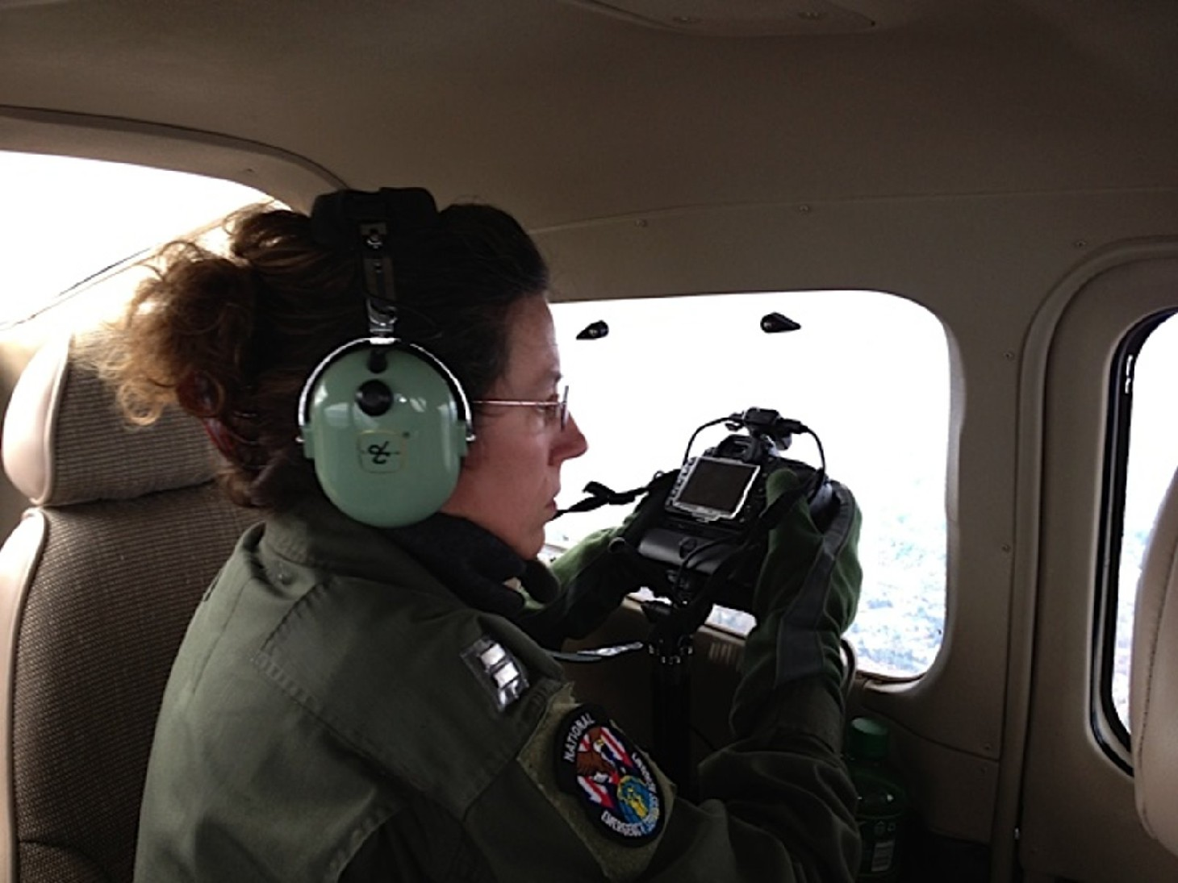
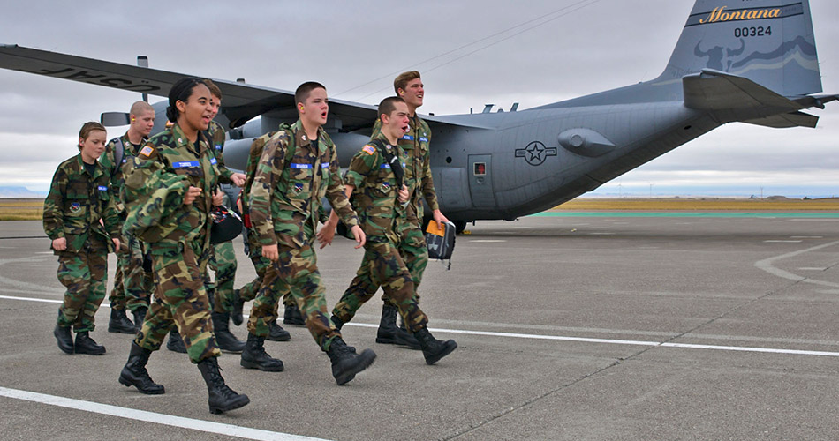
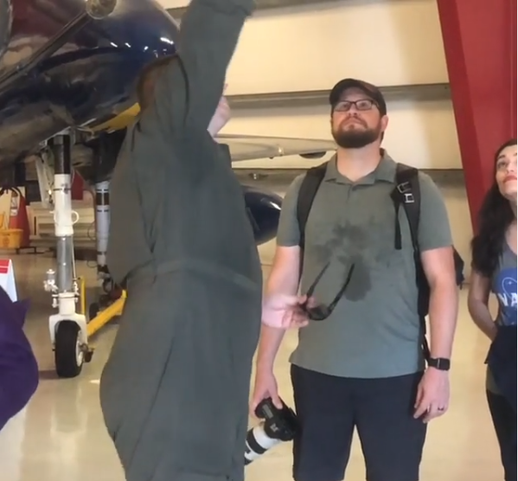
Introducing Civil Air Patrol (CAP)
Originally national defense service
U.S. Air Force Supplement
Emergency service missions
Landscape photos → Federal Gov.
Disaster assessment; search & rescue
Notes:
Joseph:
Well, introducing: the Civil Air Patrol! (press) This organization was originally chartered as a national defense service, and then now, (press) it serves as a nonprofit supplement to the U.S. Air Force. (press) One of their primary missions is to serve during emergencies for effective disaster response, and one of the ways they accomplish this (press) is by taking aerial pictures of the affected landscape of a disaster. They analyze the photos and send their analysis over to the Federal Emergency Management Association (or commonly known as FEMA) to have a more survivor-centered, efficacious response. (press) Overall, CAP uses these photos to assess the environmental context and pave the way towards search and rescue operations.

Slide 6
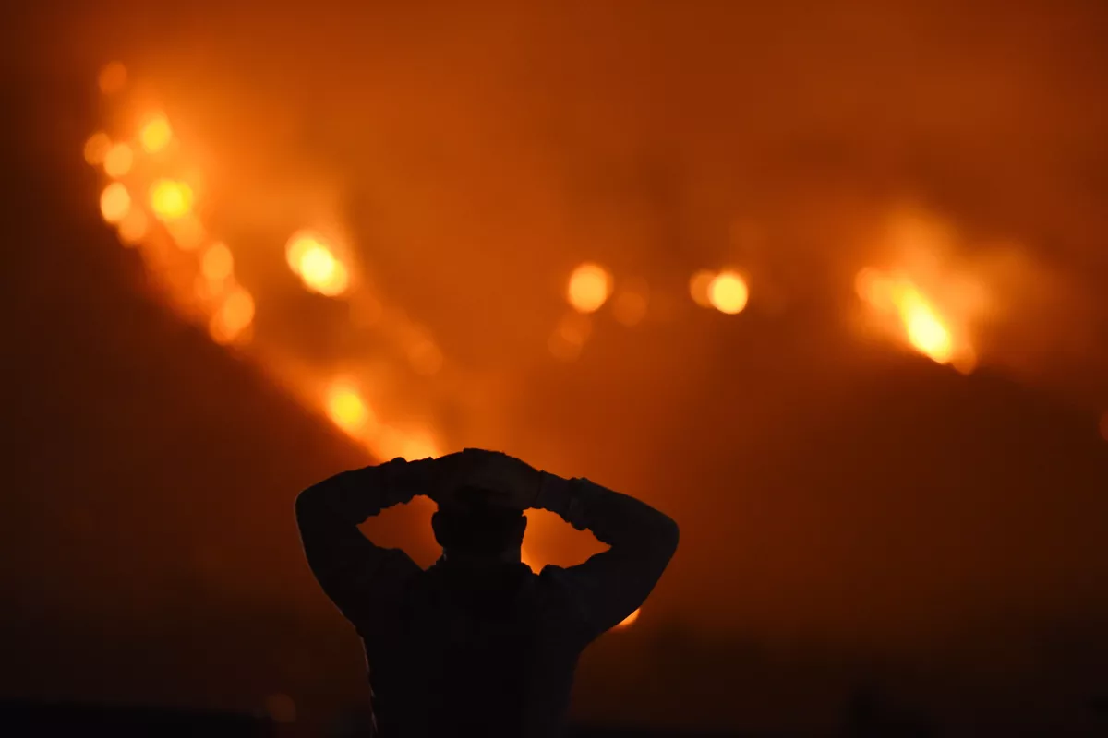

Motivation (from CAP)
Time issue
Lives on the line
Reduce time with automation
Notes:
Joseph: So, the motivation of our project is tailored to helping the CAP carry out effective search and rescue operations. The first primary factor that gets in their way, above all, is time. Lives are on the line during every moment of a disaster, so it’s essential for responders to analyze the photos quickly. However, why train responders to analyze the photos quickly when we can chunk out the vast majority of time with automation? Computers are known to be exponentially faster at calculations and can be faster at making decisions.

Slide 7
Formal Proposal
By using image-based neural networks, we speed up the disaster assessment process for first-team responders.
Notes:
Joseph:
Therefore, my proposal is to use image-based neural networks to speed up the disaster assessment process for first-team responders based on environmental and infrastructural factors.

Slide 8

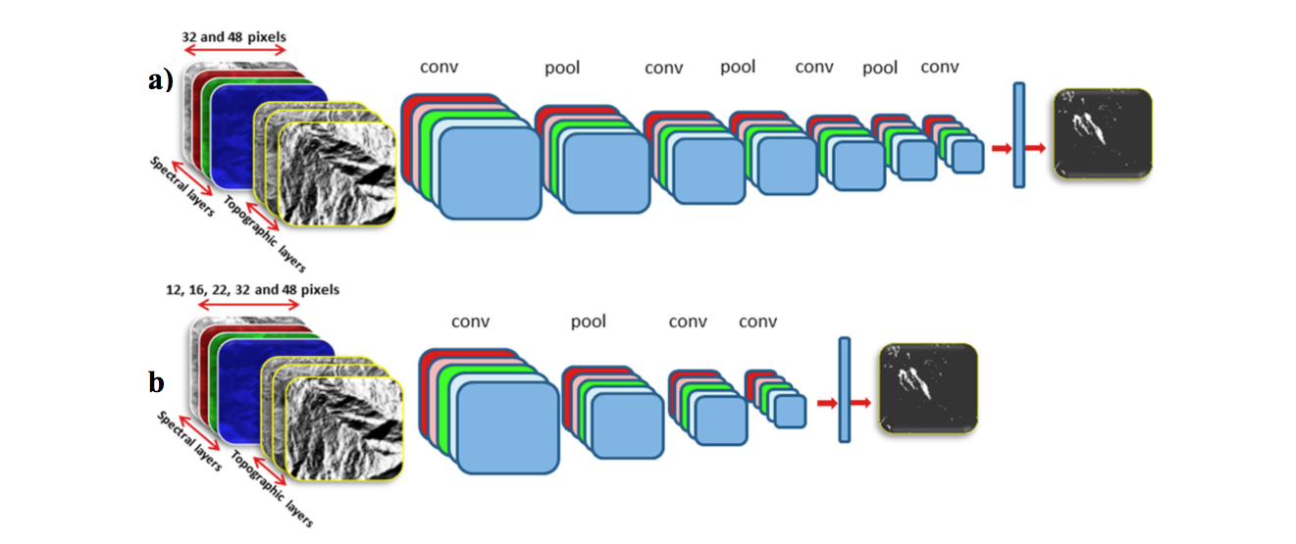
Our Solution
Easy-to-use web application
Input: image
Output: Autonomous annotations
Convolutional Neural Networks (CNNs)
Web Application
Notes:
Connor
Our solution includes an easy to use web application that can autonomously annotate images so CAP workers won’t have to. We used a convolutional neural network to annotate the images and a relatively new python library in combination with our school’s own web server.
We created a program that can take many images and autonomously annotate them, so workers at CAP won’t have to. We would also like to include several features such as, severity rating of each picture/location, and an easy-to-use website that helps navigate the large amount of images CAP takes.

Slide 9
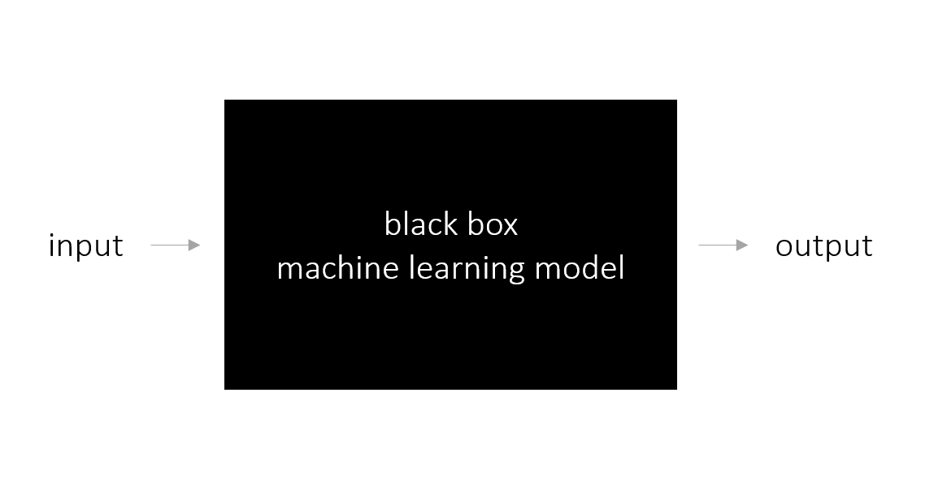

What is a CNN? (Part 1)
Error
Notes:
Joseph:
So, the basic premise behind a CNN is that it has an input and output. Intuitively of course, there has to be some means of getting from the input to the output, and the methodology of doing so is referred to as the “black box” in machine learning. In a CNN, essentially the black box converts the image into smaller and more manageable chunks and then classifies the disaster type.
Of course, a machine learning model is not perfect straight off the bat. Chances are, our CNN would produce many errors on image classification. For example, given a flooding image, our CNN might classify it as an earthquake image instead. Therefore, we train the machine learning model by learning from its errors. It’s essentially feedback, such as when you correct yourself when learning a new skill. The machine learning model corrects itself in a similar fashion, fine tuning its inner workings (or gears, you could say) so that it can improve its skill on classification.

Slide 10
CNN: The Full Picture
Notes:
Joseph:
What goes on inside of the black box is a series of convolution and pooling layers, which aim to compress and filter out details of images so that the image shrinks down to a series of numbers that the CNN can train on with efficiency. The reason all of this is done in the first place is that images are inherently large in the amount of data they contain in terms of pixels.

Slide 11
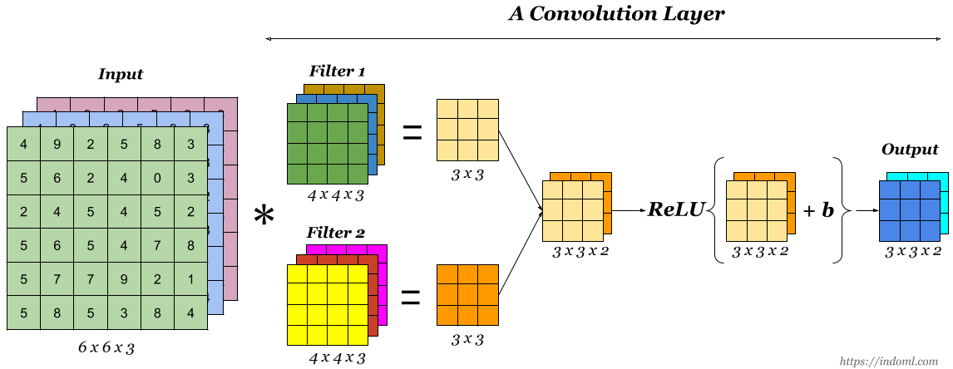
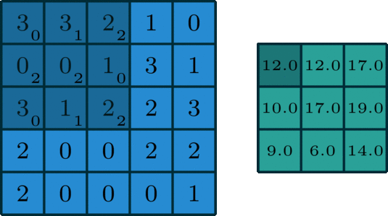
Convolution Layer
Notes:
Joseph:
(press) This image shows how a convolution layer works.
Essentially, each pixel on an image can be represented as a mixture of red, green, and blue colors (each of which have varying intensity.) The degree of intensity is represented as a number between 0 to 255. Once we split an image into RGB values, then we use filters to capture the most essential details of a photo. A filter is a small two-dimensional array of numbers that slides across a two-dimensional array of blue, green, or red values in row-major order to produce a smaller two-dimensional array, which I will call “the product.” (press) As an example, in the animation on the right, the blue 5x5 two-dimensional array is the array that is being traversed, the shadow 3x3 2D array represents the filter, and the green 2D array is the product. The filter’s numbers are represented as subscripts, with each filter number’s paired number to the left and top relative to the subscript. For each slide, the computer multiplies each pair and adds all those products to get one number in the smaller two-dimensional array product.
There can be more than one filter in use so that a computer can detect a diverse amount of relevant details. For example, one filter might be used for detecting cars and the other might be used to detect water. Going back to the image on the left, the computer repeats this entire process for each color for each filter, and then adds all the products up to create the summed 3x3 2D array. Then, the two products are overlaid on one another to get a 3x3x2 3D matrix. The computer runs that 3D matrix through a mathematical function, and in the photo’s case, it is the RELU function, where basically the function outputs 0 if a number is negative and 1 otherwise. The “b” is the bias, which is a number that can be added to the matrix for scaling purposes.
In the big picture, all of the things that make up these calculations, such as the filters and the biases, are able to be fine tuned in their numbers to improve a CNN’s accuracy, as I mentioned earlier. That is all part of the “changing gears” analogy I brought up earlier.

Slide 12

Pooling Layer
Notes:
Joseph:
After a convolution layer, the processed image then passes onto a pooling layer. They function very similarly in the sense that the processed image is yet again being traversed (except no overlap this time in traversing), but instead of multiplying corresponding numbers and summing them together, the computer is instead taking the maximum or the average of each small 2D array. For example, as seen in this image, it is divided in two parts by red, yellow, blue, and green. Then, the image is showing the possibilities of pooling layers, which could be taking the maximum number from each colored array on the average of all four numbers for each colored array. Either way of using max pooling or average pooling accomplishes the same goal of shrinking down an image, and which one to choose is up to the trainer of a CNN or pre-determined depending on the software library he/she is using to train the CNN.

Slide 13
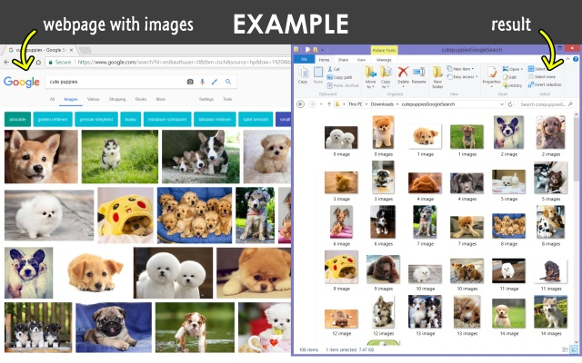
Single-label CNN
Purpose:
classify disaster type
prep. for multi-label CNN
Means:
Google Images
“Download All Images” Chrome extension
1000 images per disaster
Earthquake, fire, flooding, hurricane, and normal
Fast.ai (accessible AI)
Google Colaboratory
Notes:
Connor
We created a CNN that classified an image as one label to differentiate between the different types of disasters. We also thought this would help us prepare for the when we trained a CNN to classify multiple labels.
Our CNN was trained on images we downloaded off of google using the Download All Images Chrome Extension. We downloaded 1000 images per disaster. However some images had errors or were not correctly formatted, so we lost a few here and there. We used fast ai which is a python library with precoded neural network frameworks that makes it easier for us to train a NN. We used google colaboratory because its format is helpful when debugging and it allows us to both work on the file with no difficulty.

Slide 14

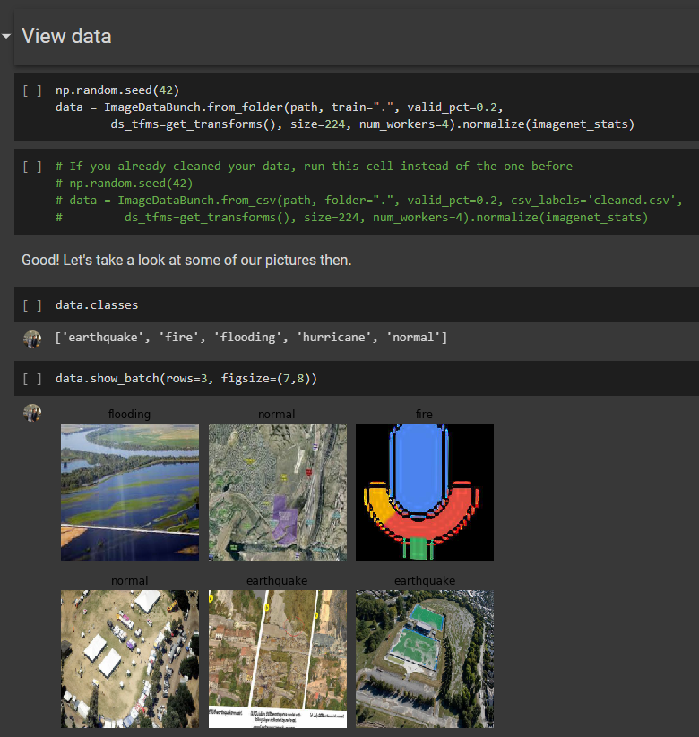
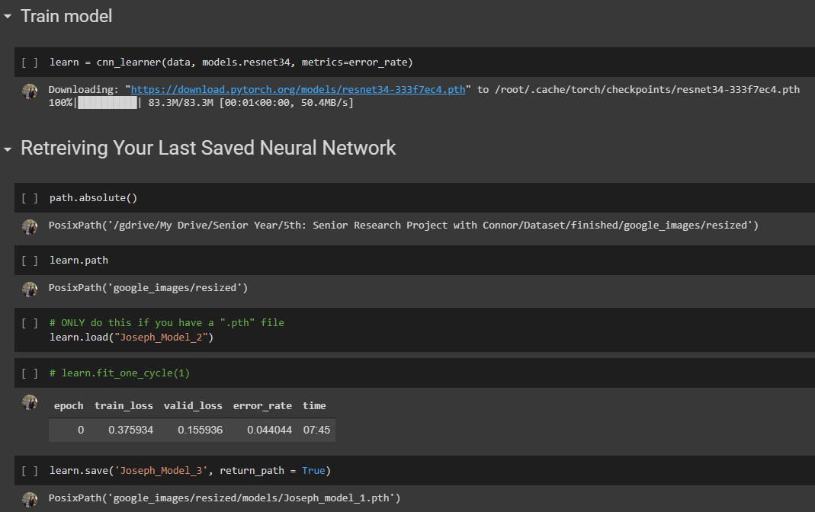
Notes:
Connor
Here are some snippets of code
(Explanation of code goes here)

Slide 15
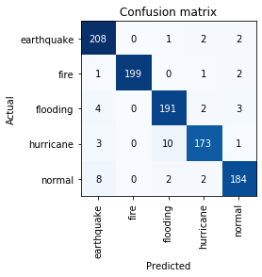
Single-label CNN Results
4.40% error
Notes:
Connor

Slide 16
Multi-label CNN
Purpose:
classify disaster type(s) + details
Environment + infrastructure
Means:
Google Images
Dataset: 500 images
100 per disaster
Reasoning: manual annotation time
Relied on retrain feature
fast.ai (accessible AI)
Notes:
Joseph:
Of course, once the single-label CNN was finished, we moved on the multi-label CNN, (press) whose purpose was to not only classify disaster types in a certain aerial photo but also other relevant details based on environmental and infrastructural factors. (press) Our means for this CNN is highly similar to the single-label CNN (press) where we utilized Google Images, (press) except now we worked with a dataset of 500 images. The overall organization was still the same, where I had an equal amount of photos for each disaster, so that means (press) 100 images per disaster type. (press) Training a single-label CNN was easier in the process because we only had to organize photos by their disaster type, and that was why we had a much larger dataset without having to spend more than a day to craft it Now, with a multi-label CNN, we realized that annotating 5000 images would take forever, and so we stuck with 500 instead as a more reasonable amount.
We knew in the end, a dataset of 500 images would not be sufficient for high accuracy when tested, (press) so we relied on creating a retrain feature on the Multi-label CNN, which is based on user input. We discuss about this feature in depth later in the presentation.
(press) It was nice that fast.ai supported multilabel CNN training as well, so we kept using it.

Slide 17
Multi-label CNN Environmental + Infrastructural Considerations
Structural damage
Road
Low vegetation
High vegetation
River
Rough Terrain
Notes:
Joseph:
So, here are all the environmental and infrastructural classifications of my multilabel CNN network. It can classify whether or not there is: (read off of the list)

Slide 18

Multi-label CNN Results
Results after training:
Notes:
Joseph:
Here are the results of the Multi-Label CNN. The training loss, which tells what fraction of the training images my Multilabel CNN classified incorrectly, was surprisingly low at around 2.9%. However, what was quite surprising was that the validation loss, which is the fraction of the testing images (or the images that my multilabel CNN has not been trained on before) my multilabel CNN classified incorrectly, was 93.5%. Since there were six more possible classifications compared to single-label plus the fact that no two classifications were mutually exclusive, it would make sense why 93.5% should not be surprising, especially with only 500 images as a dataset.
In addition, I wanted to point out the fbeta score, which was only 59.8%, where 90+% would have been ideal. You might be wondering “What is this fbeta score and why is it relevant?” Well, “fbeta” is also another important metric when testing out the accuracy of my multilabel CNN. For our multilabel CNN training, we had to deal with what is called an “imbalanced classification” problem in machine learning. This type of problem occurs because of an imbalanced training set. In our case, even though we had an equal amount of disaster photos by disaster category such as flooding or hurricane, it was most likely that for our environmental and infrastructural categories, we did not have an equal amount of photos for each of those categories. Since no two categories are mutually exclusive, pairs, triplets, and quadruplets of all the multilabel categories were most definitely not equal in amount either. Fbeta score is an indicator of how well my neural network in the face on an imbalanced data set.

Slide 19

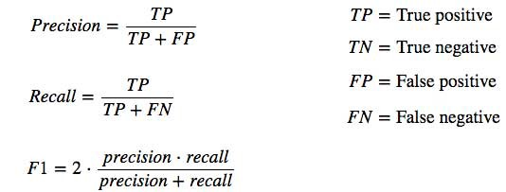
Fbeta Score Explanation
Notes:
Joseph:
The reason that fbeta is useful for imbalanced classification is that it takes into account two other metrics: precision and recall. To understand both of these metrics, we just need to understand what true positives, false positives, and false negatives are.
“True positives” means the amount of data points (or photos) in our case our neural network predicted correctly for a certain category. For example, (press) if we choose “earthquake” as a category, the number of true positives is 208, since that is the only number that intersects with the “predicted earthquake” column and the “actual earthquake” row.
(press) “False positives” mean the rest of the data points the neural network thought was a certain category but was actually not that category. In our earthquake case, that would be 1 + 4 + 3 + 8 as seen in the “earthquake predicted” column. The number of true positives divided by the sum of true positives and false positives therefore answers the question “What fraction of the total amount of data points (or images in our case) that a neural network thinks belongs to a certain category actually belong to that category?”
(press) “False negatives” is the amount of data points that a neural network thinks is not a certain category, but is that certain category instead. In the earthquake example, (press) it would be 0 + 1 + 2 + 2 from the green oval on the “actual earthquake” column because “0” is predicted fire and earthquake, “1” is predicted flooding and actual earthquake, the first two is “predicted hurricane” and “actual earthquake” and the last two is “predicted normal” and “actual earthquake.” Therefore, from the formula, recall essentially asks the question: “What fraction of the total amount of data points that truly represents a certain category did the neural network predict was that actual category?
F-beta tries to take into account both of these metrics and mesh them into a singular metric. One choose a value of beta, which may either give more weight to precision, recall, or give both equal weight. We used a value of 0.2, which gives more weight to precision.

Slide 20
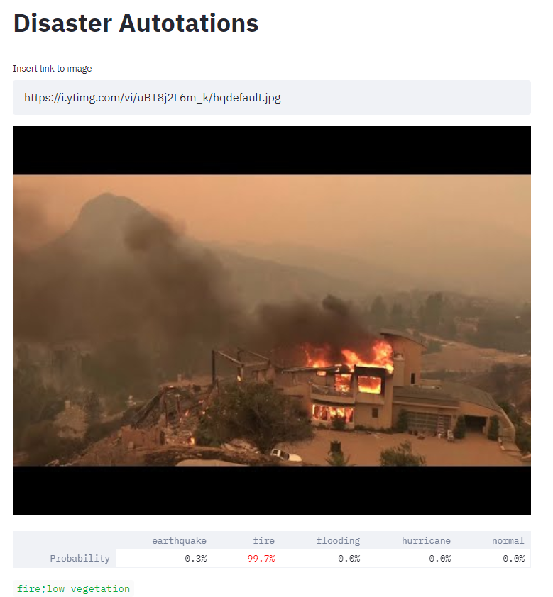
Web App
Purpose:
User interaction (CAP/normal)
Retrain (user input)
Means:
Director (accessible web app dev.)
Streamlit
Features
Inputs
Link
Photo upload
Output: annotations
Notes:
Connor
The purpose of our webapp is to create a nice user interface for any potential users. We created this by using TJ Director and streamlit. Director is a web app deployment service and streamlit is a python package design to make web apps. Our webapp lets the user input a link or uplaod an image and get annotations back as a result.

Slide 21

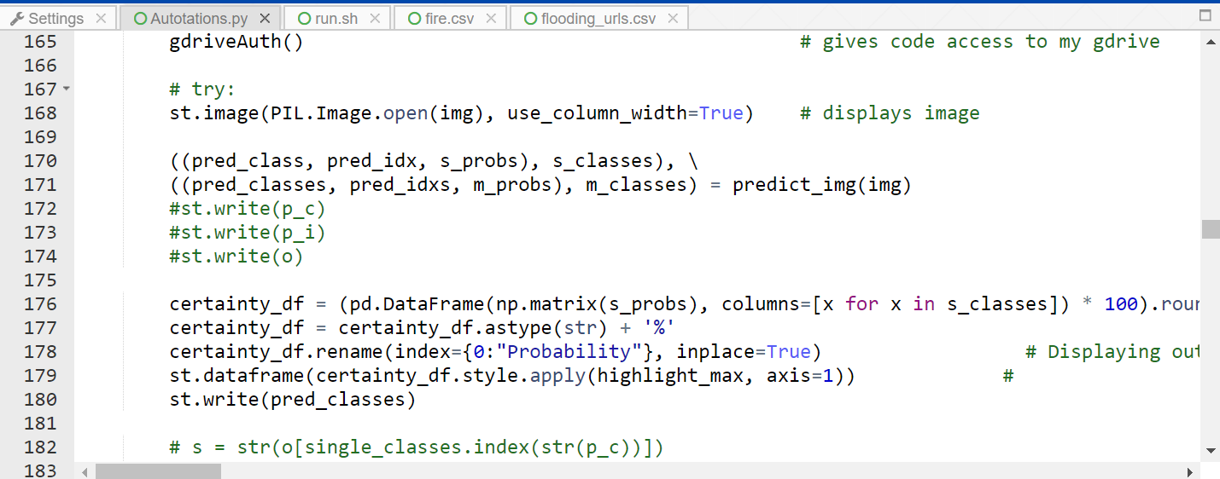
Notes:
Connor

Slide 22
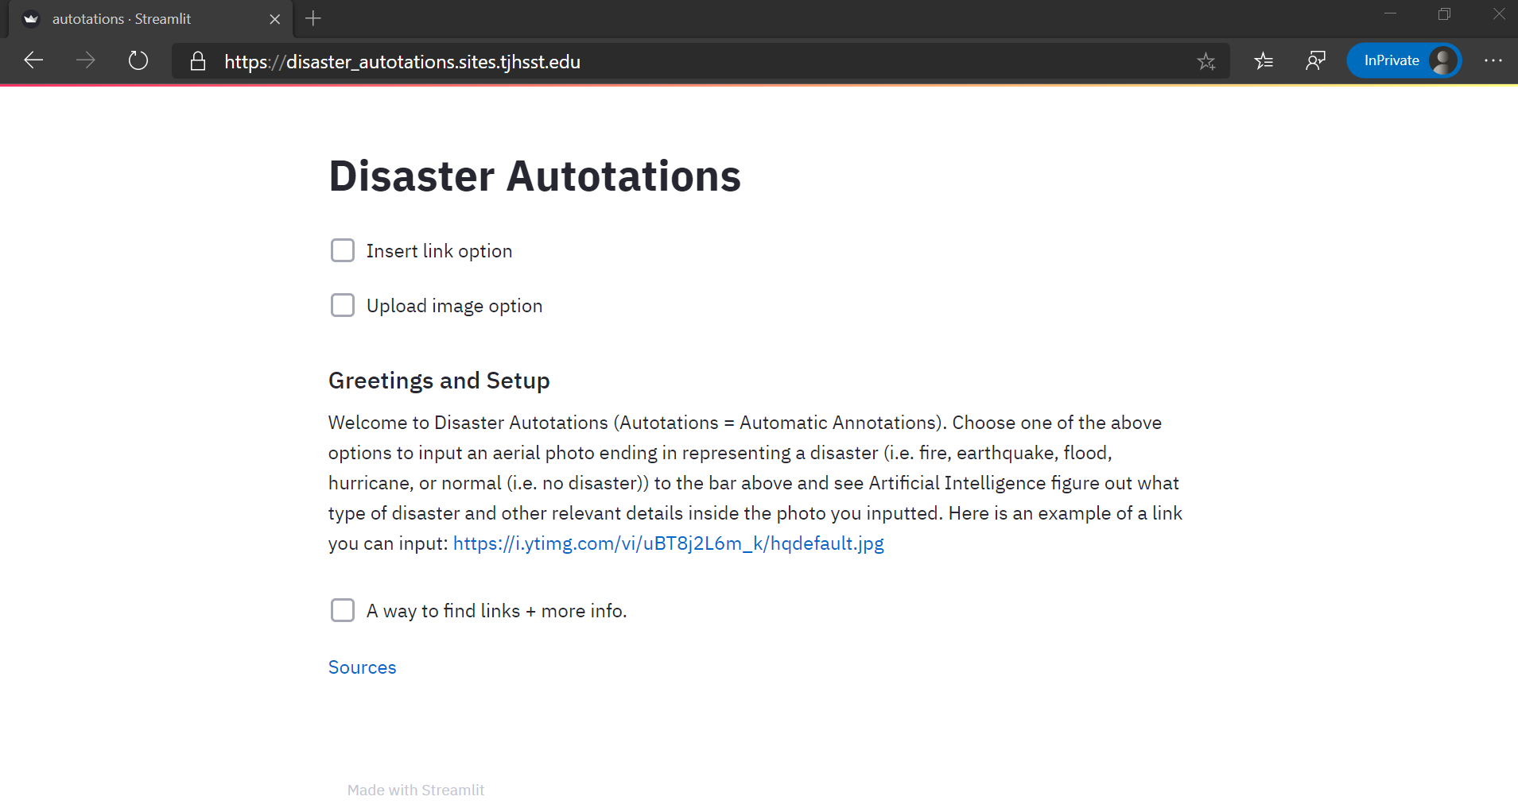
Notes:
Connor

Slide 23
Retrain
Purpose:
Refine accuracy of NN
Adapt to new looks
Method:
Send user generated labels and images to a server (currently my computer)
Daily retrain of the NN
Preserve the highest accuracy version
Flaws:
Relies on user accuracy
Long-term changes
Currently unreliable implementation
Notes:
Connor

Slide 24
Notes:
Connor
These are some code cells from our retrain code. The first 3 cells have to do with letting the code work without having to use a password.There is an easier and faster way to do this that we thought about later. The last 2 cells deal with choosing the best NN model and then putting the best one in a folder that the webapp will use.

Slide 25
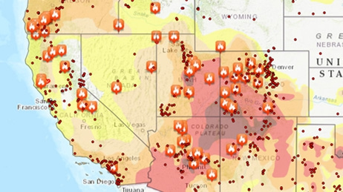
Avenues for Improvement
Future of this project?
JOIN the effort!
Potential avenues:
Severity rating
Efficient escape routes
Creation of optimal datasets
People detection (search & rescue)
Notes:
Joseph:
(press) Well, will there be a future for this project? (press) Yes, there will be, especially for prospective students looking to participate in Computer Systems Research next year or in the following years. Part of the beauty behind research is that even though my partner and I’s time has run out for this research, that does not prevent it from other people building off our project to achieve greater things. “What are some of these greater things?” you guys may ask. (press) Potential avenues for extending this project include: a severity rating. Essentially, this would have been the next milestone of our research had we have more time. This avenue essentially works by giving a ranking system to a folder of images taken by the Civil Air Patrol for a certain area. A ranking system would most definitely help the Civil Air Patrol locate priority locations for search and rescue operations.
(press) Then, after that milestone, we were then planning on creating efficient escape routes for particular cities or towns that were affected by certain disasters so that if a similar disaster were to occur again, then people would know how to escape in the most efficient way possible. Calculating the most efficient escape routes would be based on the disaster assessment of the last disaster struck area, and of course, imagery automatic annotation can assist with that process.
(press) Another potential avenue is the creation of optimal datasets that would balance out each of the different categories as I described earlier. A way to accomplish making these types of datasets could be via Generative Adversarial Networks, which is another type of machine learning algorithm.
(press) Of course, to supplement the first three avenues, it would be nice to have the neural networks we trained also capable of detecting people. Sometimes, due to smoke from a disaster or a high-vegetation environment, people are challenging to detect with the naked human eye, so it would be nice if someone could investigate how to make neural networks detect endangered people during a disaster.
Overall, I hope these four avenues of improvement gave future Computer Systems scientists an inspiration for their own research ideas or to extend off of our project.

Slide 26
Credits
Directors Mr. White and Dr. Gabor
Remote Sensing for Disaster Response course
Other TJ peers involved with feedback
Notes:
Joseph:
We would like to thank:
(press) Our research directors, Mr. White and Dr. Gabor for their guidance.
(press) My Remote Sensing for Disaster Response course, which gave birth to this disaster response research idea in the first place.
(press) And finally, other TJ peers who were involved with the feedback of our web application.

Slide 27
References
References
AllGov. (2016). Federal Emergency Management Agency (FEMA). Retrieved January 24, 2020, from http://www.allgov.com/ website: http://www.allgov.com/departments/department-of-homeland-security/federal-emergency-management-agency-fema?agencyid=7345
Associated Press. (2018, October 15). United Nations Report Says 1.3 Million Killed by Natural Disasters in Last 20 Years as Costs of Climate Disasters Rise Dramatically [Press release]. Retrieved from https://weather.com/science/environment/news/2018-10-15-united-nations-earthquakes-tsunamis-climate-disasters#3
Notes:
Joseph:
Here are our references.

Slide 28
References
Civil Air Patrol. (n.d.). WHO WE ARE. Retrieved January 24, 2020, from https://www.gocivilairpatrol.com/ website: https://www.gocivilairpatrol.com/about/who-we-are
FEMA HQTV. (2019, October 24). FEMA Logo (Blue) [Image]. Retrieved from https://www.fema.gov/media-library/assets/images/183891
Hui, J. (2018, March 6). mAP (mean Average Precision) for Object Detection. Retrieved April 6, 2020, from https://medium.com/@jonathan_hui/map-mean-average-precision-for-object-detection-45c121a31173
Milman, O. (2018, October 16). From Harvey to Michael: how America's year of major hurricanes unfolded. The Guardian. Retrieved from https://www.theguardian.com/world/2018/oct/15/us-year-of-hurricanes-extreme-michael-irma-florence

Slide 29
References
Penven, M. D. (2012, November 9). NC Wing, CAP Completes First Wave of Aerial Photo Missions. Retrieved February 3, 2020, from Civil Air Patrol, North Carolina Wing website: https://www.ncwgcap.org/index.cfm?fuseaction=article.display&articleID=359&page=1
Phung, V. H., & Rhee, E. J. (2019, October 23). [schematic diagram of a basic convolutional neural network (CNN) architecture]. Retrieved from https://www.researchgate.net/figure/Schematic-diagram-of-a-basic-convolutional-neural-network-CNN-architecture-26_fig1_336805909

Slide 30
References
Pokhrel, S. (2019, September 19). [Illustration of a convolution layer]. Retrieved from https://miro.medium.com/max/2292/1*u2el-HrqRPVk7x0xlvs_CA.png
[Pooling layer example]. (n.d.). Retrieved from https://qph.fs.quoracdn.net/main-qimg-cf2833a40f946faf04163bc28517959c
Riggio, C. (2019, Nov 1). What's the deal with Accuracy, Precision, Recall and F1? Retrieved April 7, 2020, from https://towardsdatascience.com/whats-the-deal-with-accuracy-precision-recall-and-f1-f5d8b4db1021
Wang, T. (2020, January 24). Annual number of natural disaster events globally from 2000 to 2019 [Fact sheet]. Retrieved April 6, 2020, from https://www.statista.com/statistics/510959/number-of-natural-disasters-events-globally/

Slide 31
References
Wildfires. (n.d.). Retrieved February 9, 2020, from Esri website: https://www.esri.com/en-us/disaster-response/disasters/wildfires
Zhang, G. (2018, Nov 26). How To Evaluate Your Machine Learning Models? — Classification Evaluation Metrics. Retrieved April 6, 2020, from https://medium.com/@zxr.nju/how-to-evaluate-your-machine-learning-models-classification-evaluation-metrics-4670aef877ec

